Slide 1


Prediction of the Housing Price Using Machine Learning Tools
Ehsan Gharib-Nezhad
General Assembly Fellow
August 24 2021
www.EhsanGharibNezhad.github.io
@ExoEhsan

Slide 2

Challenges with House Marketing
(Illustrations by Jean-François Martin, washingtonpost)

Slide 3
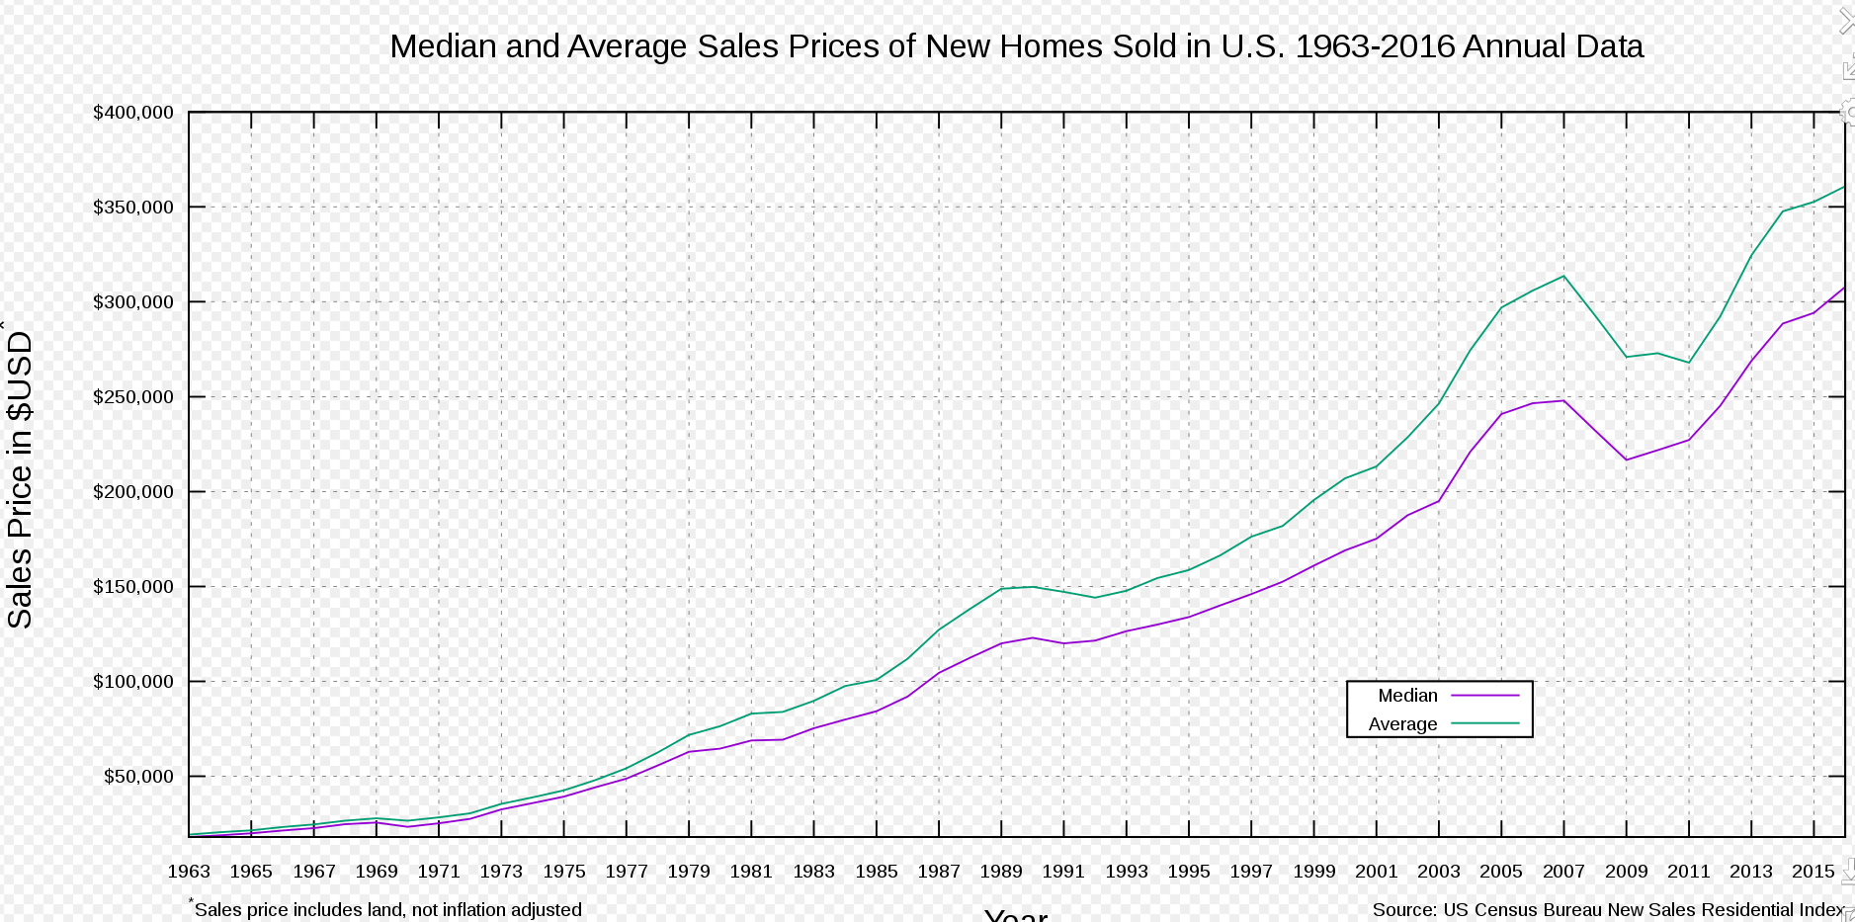
House Market Since 1963
2009
A total of 3,957,643 foreclosures
>2.21 % of all households were in some stage of foreclosure during 2009, up from 1.84 percent in 2008.
2006
One in 92 of all households were in some stage of foreclosure during 2006
2007
largest U.S. subprime lender, files bankruptcy
worldwide "credit crunch”
DOW closes above 14,000
2010
The Median Home Price dropped to $218,200, while the Average Home Price was $283,400 at 2005.
A total of 3,825,637 foreclosures
2008
Home sales continue to fall
Fears of a U.S. recession
Global stock market corrections and volatility.
3

Slide 4
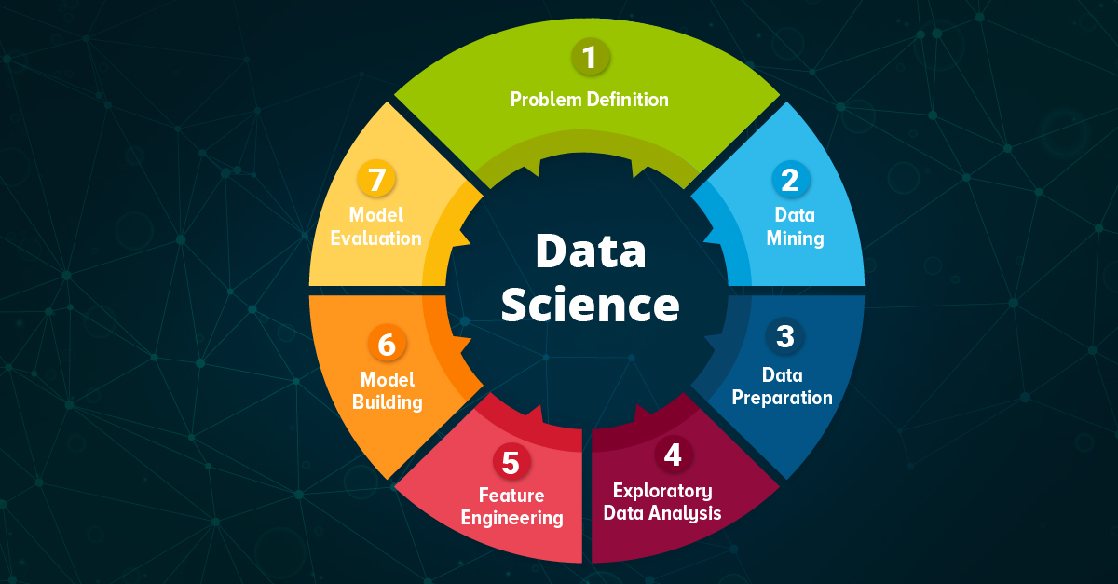
www.aismartz.com

Slide 5
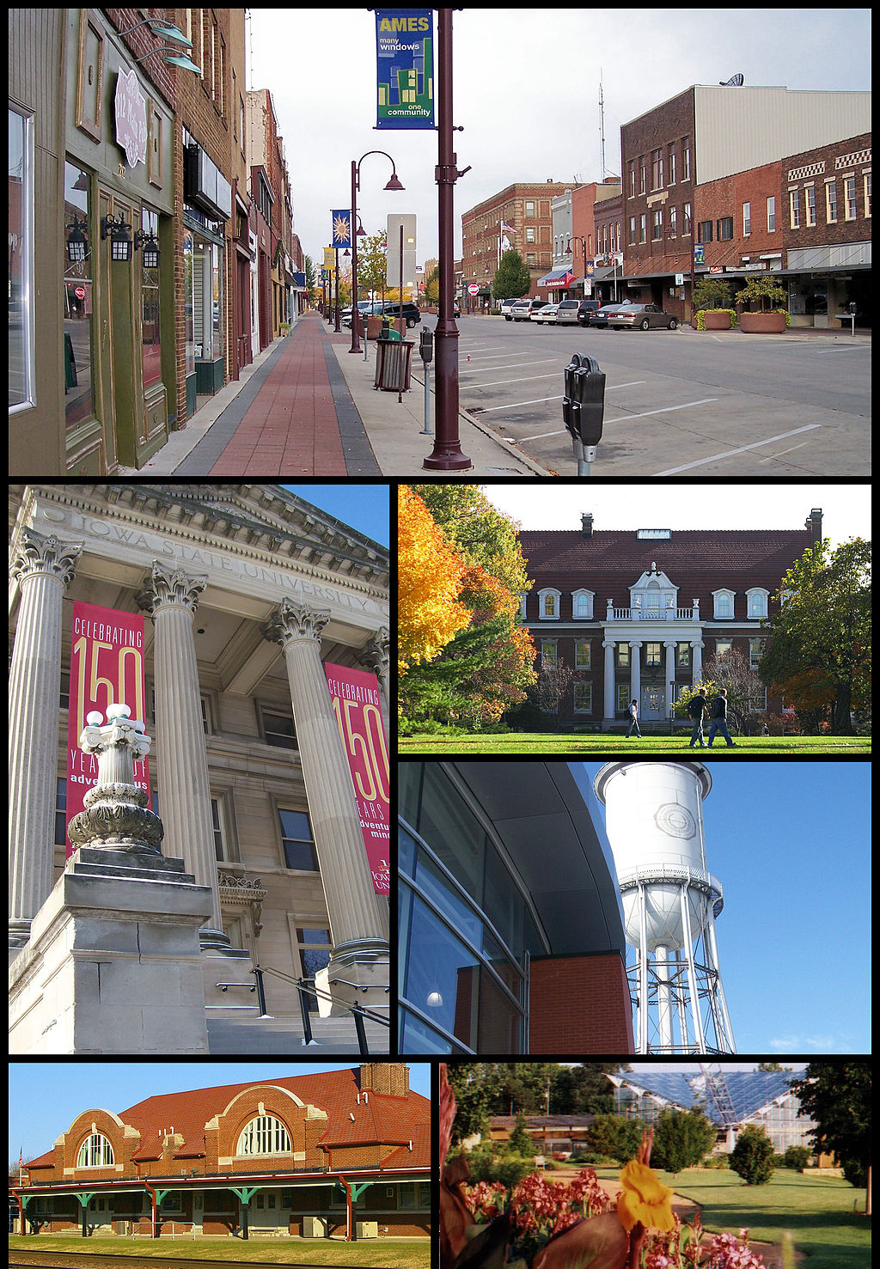
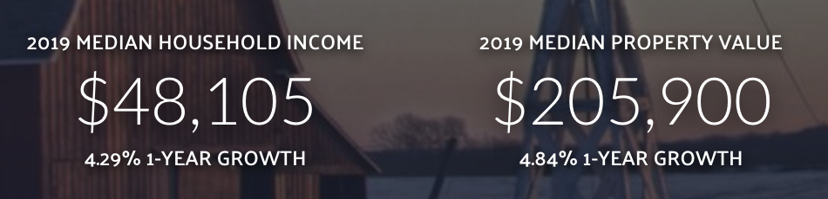
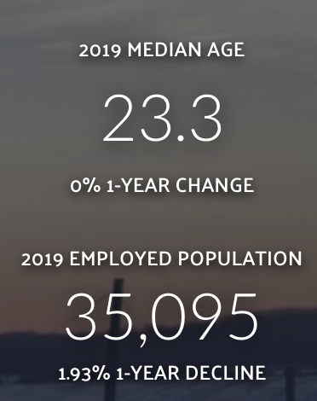
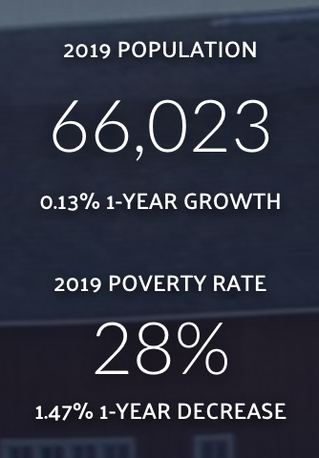
Iowa Ames Dataset
https://datausa.io

Slide 6
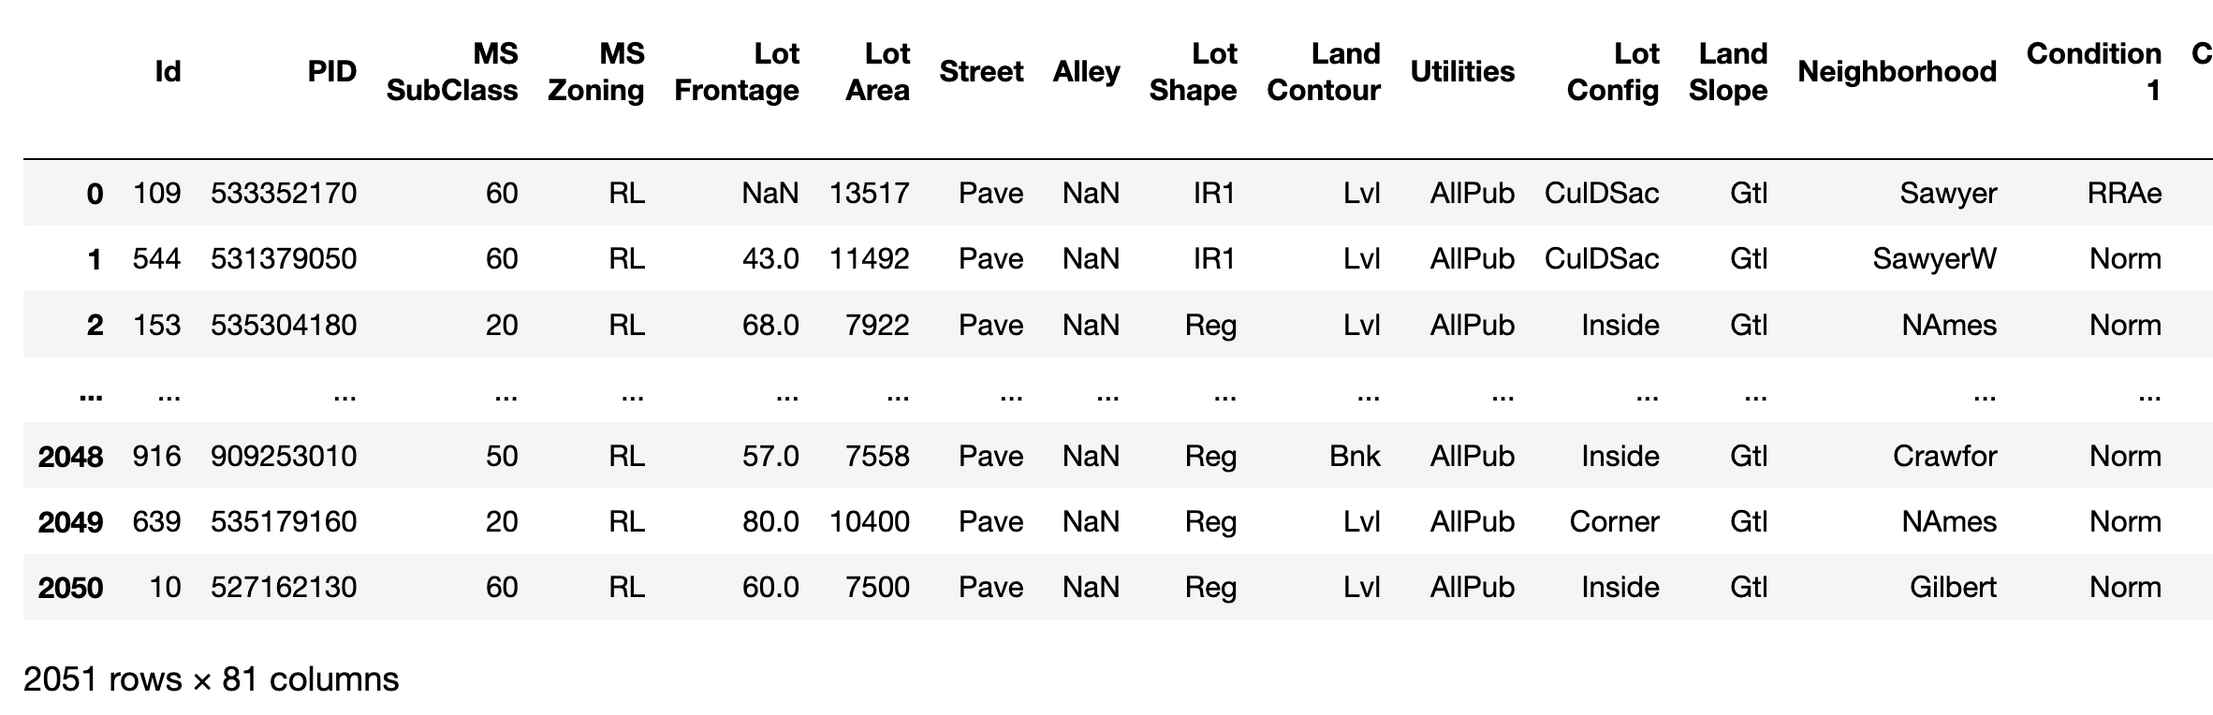
Dataset Resource
NAME: AmesHousing.txt
TYPE: Population
SIZE: 2930 observations, 81 variables
Date range: 2006 – 2010
ARTICLE TITLE: Ames Iowa: Alternative to the Boston Housing Data Set
Author: Dean De Cock Truman State University Ref: Journal of Statistics Education Volume 19, Number 3(2011)
6

Slide 7
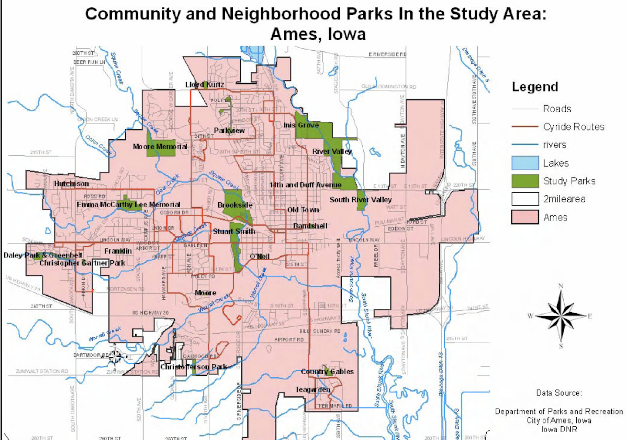
www.semanticscholar.org

Slide 8


Data Cleaning
Edvard Munch, 1893
⚠️ Your Analysis is as good as your data.

Slide 9
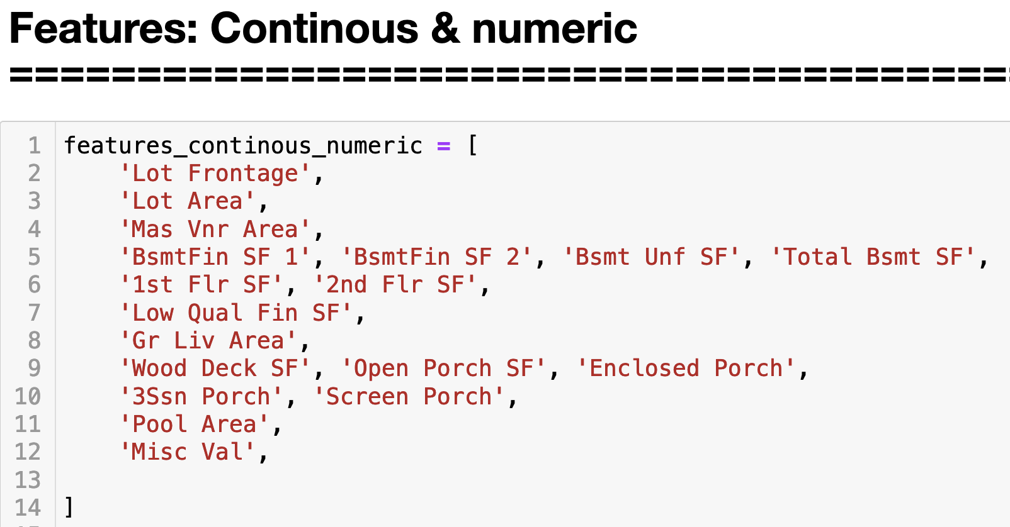
features_continous_numeric: Nulls treatment
9

Slide 10
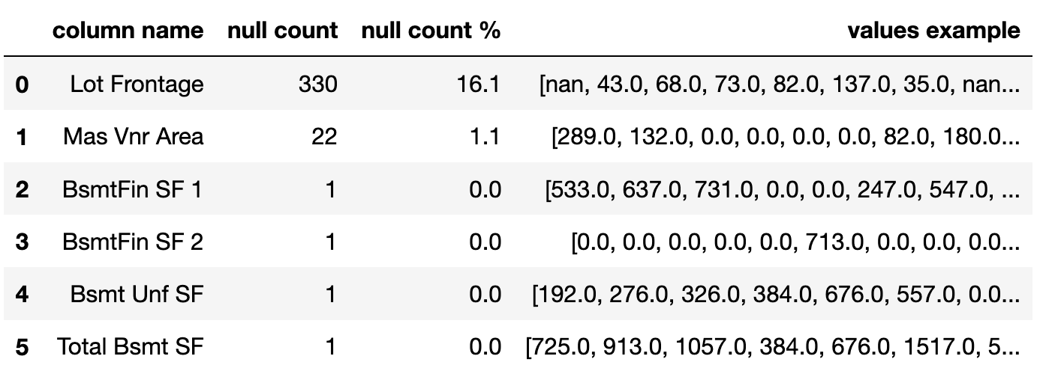
features_continous_numeric
Nulls replaced with mean
Rows with Nulls dropped!
10

Slide 11
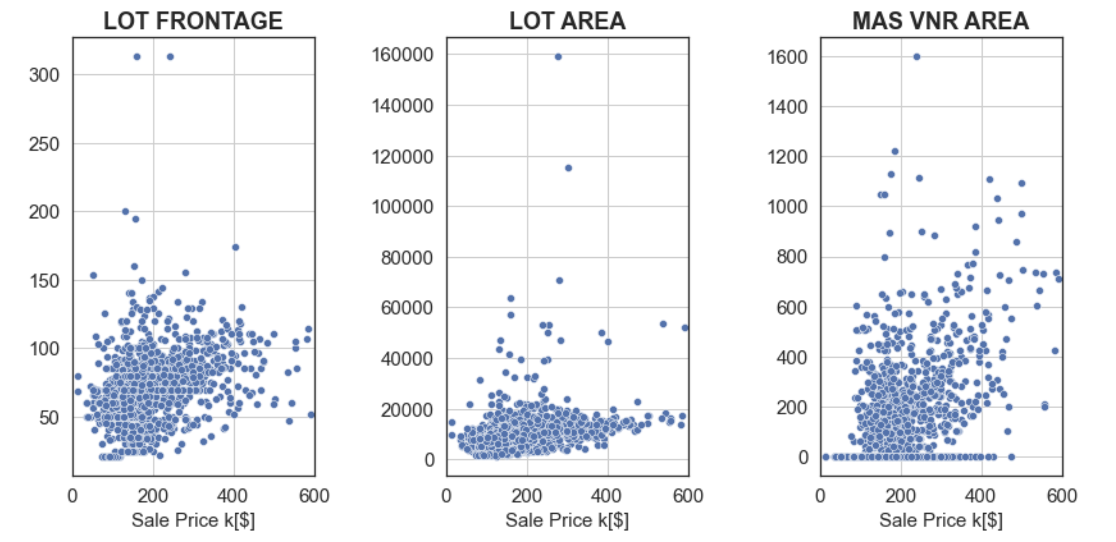
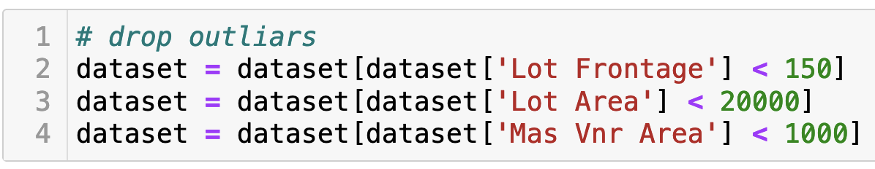
features_continous_numeric: Outliars
11

Slide 12
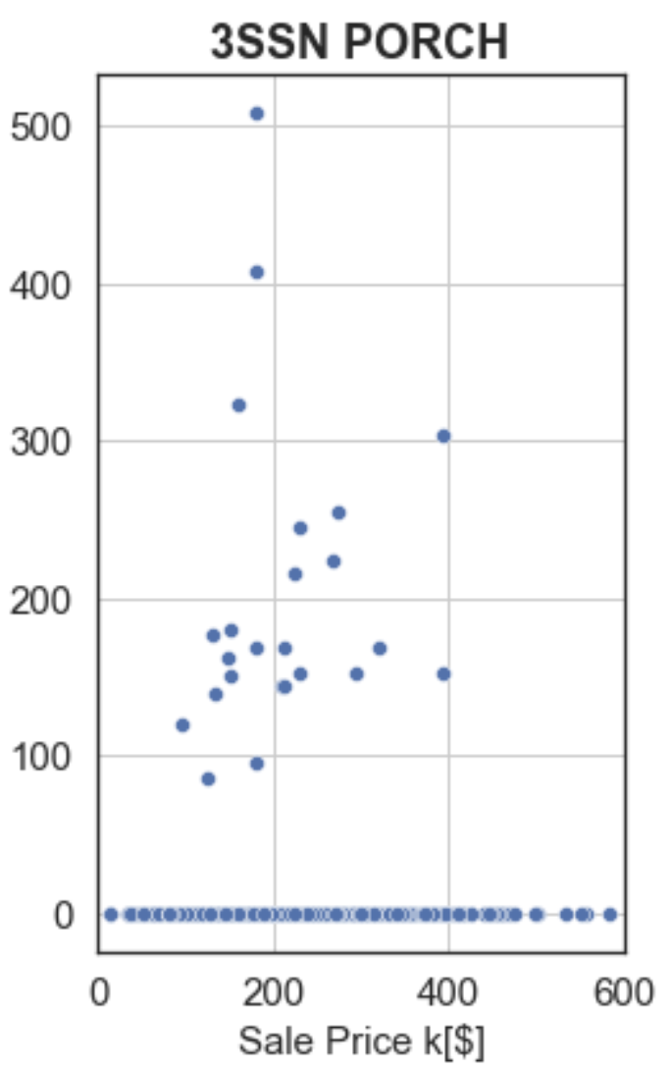
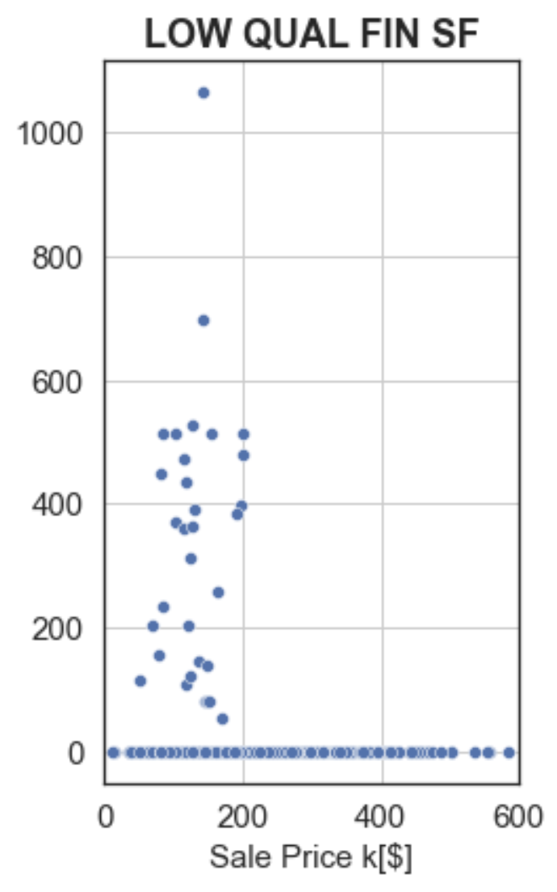
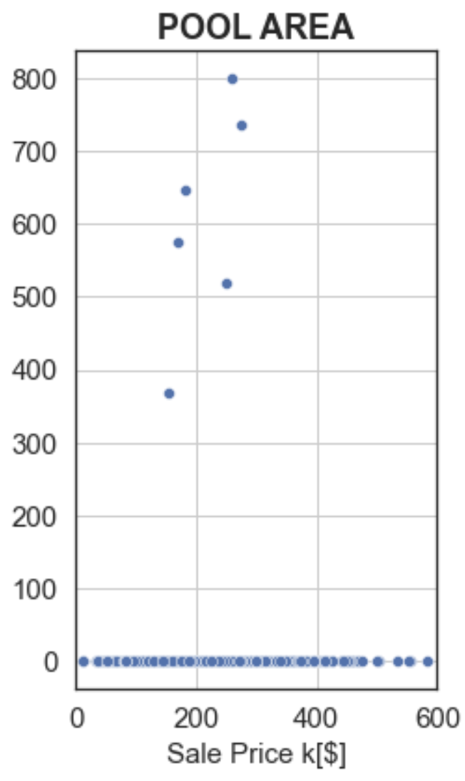
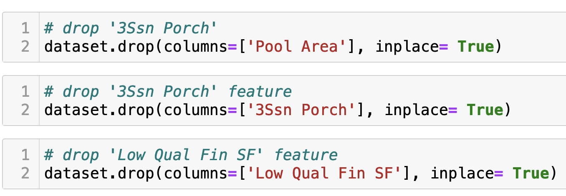
features_continous_numeric: Drop Features
12

Slide 13
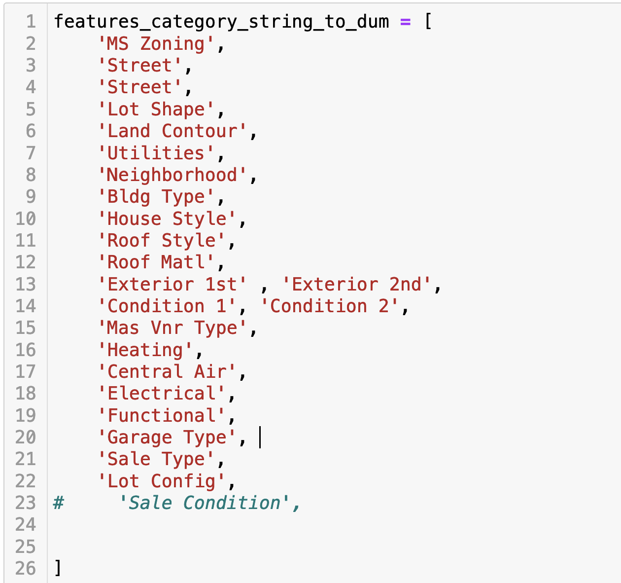
features_category_string_to_dum
13

Slide 14
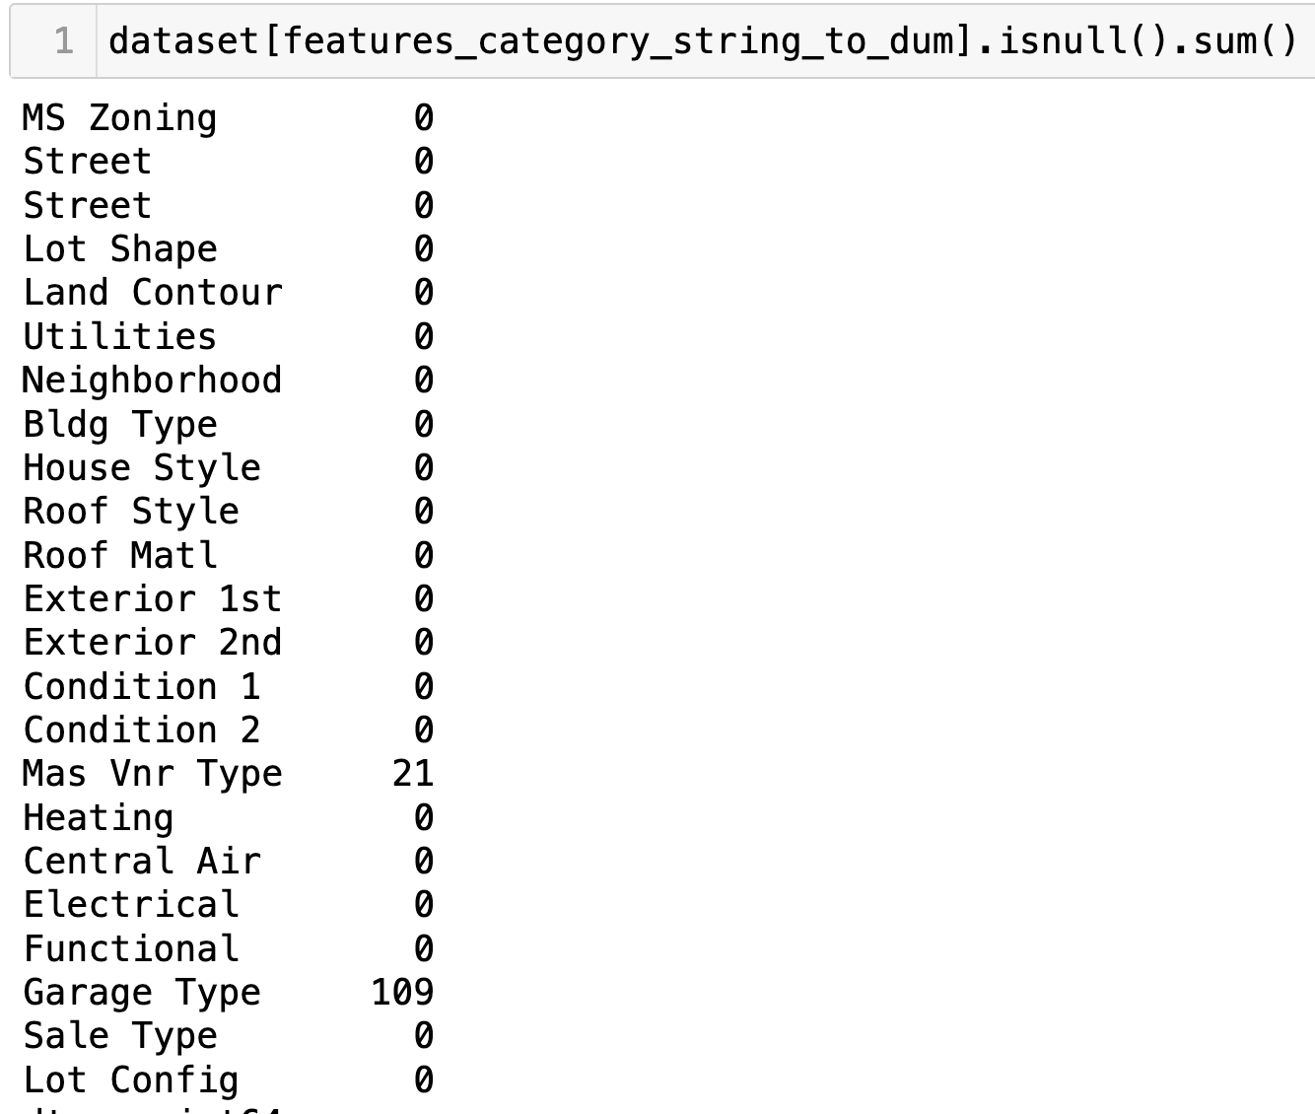
features_category_string_to_dum: Null Treatment
14

Slide 15
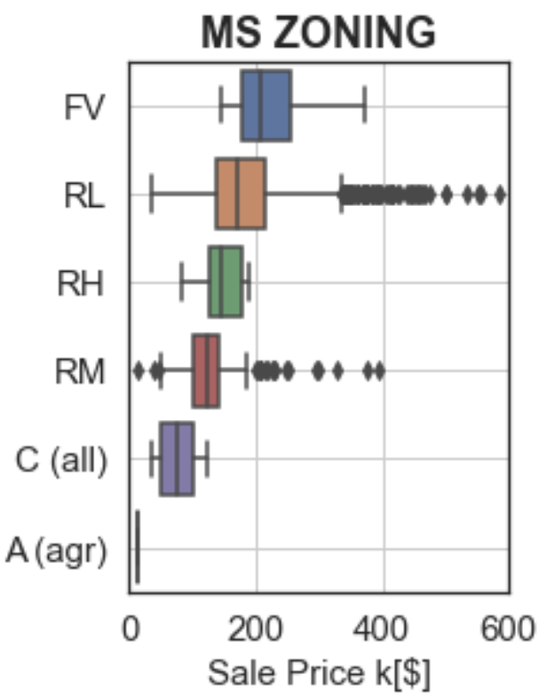
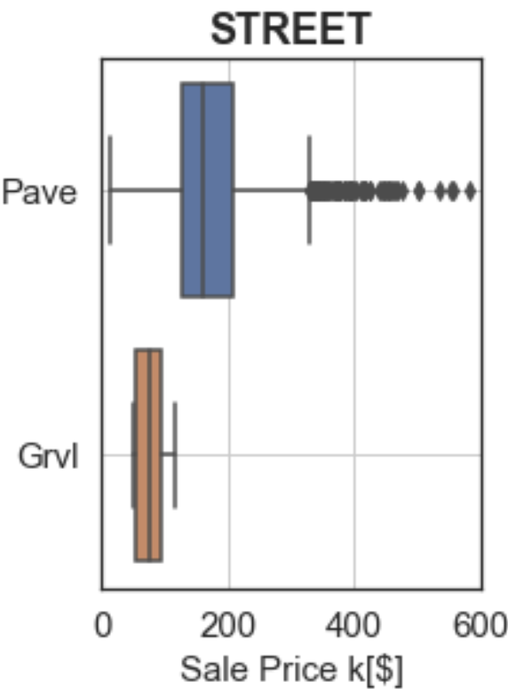
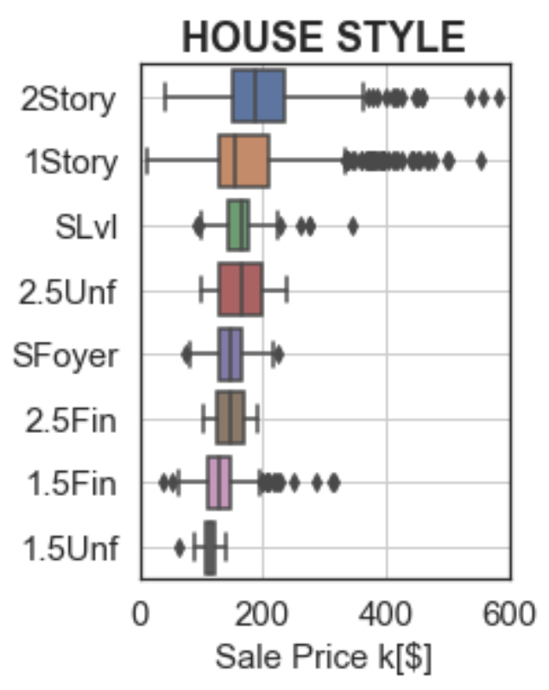
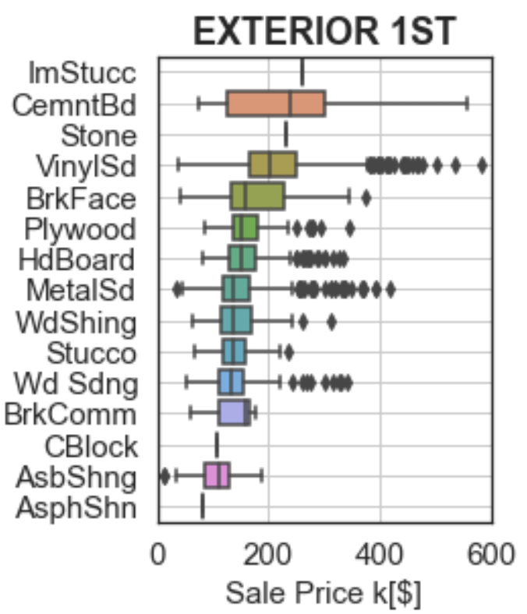
features_category_string_to_dum: Example of dataset
15

Slide 16
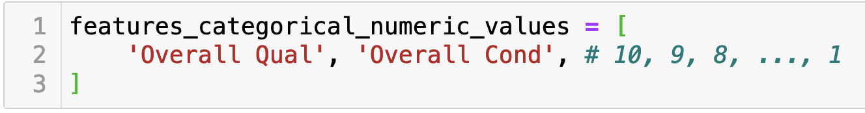
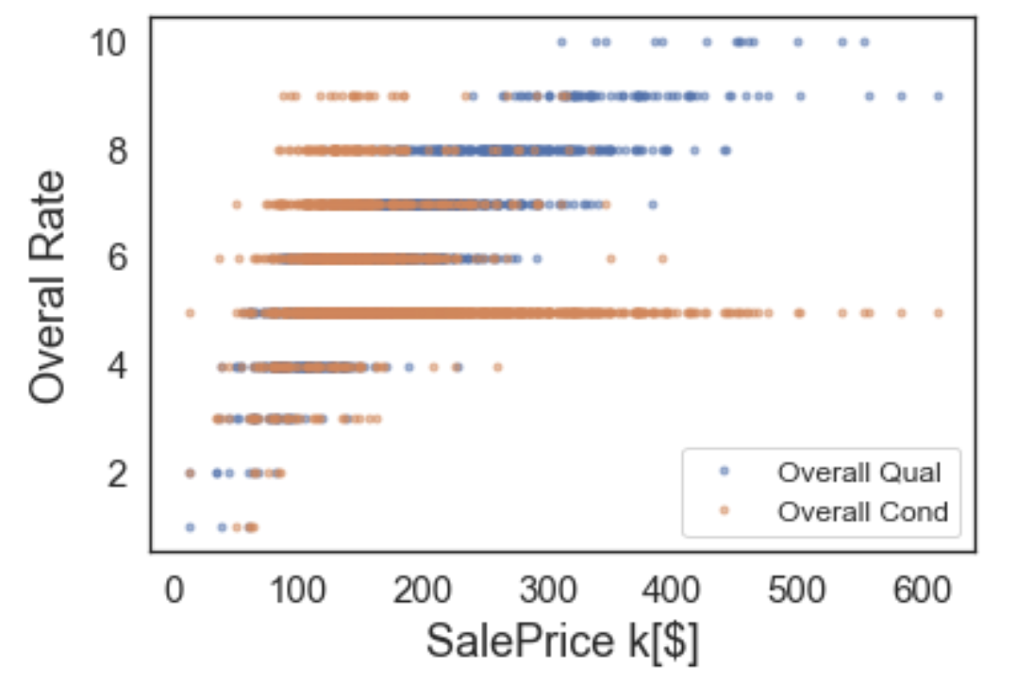
features_categorical_numeric_values
16

Slide 17
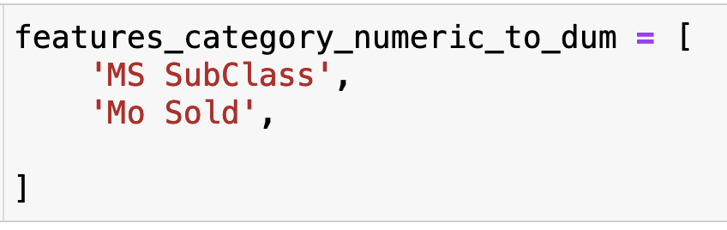
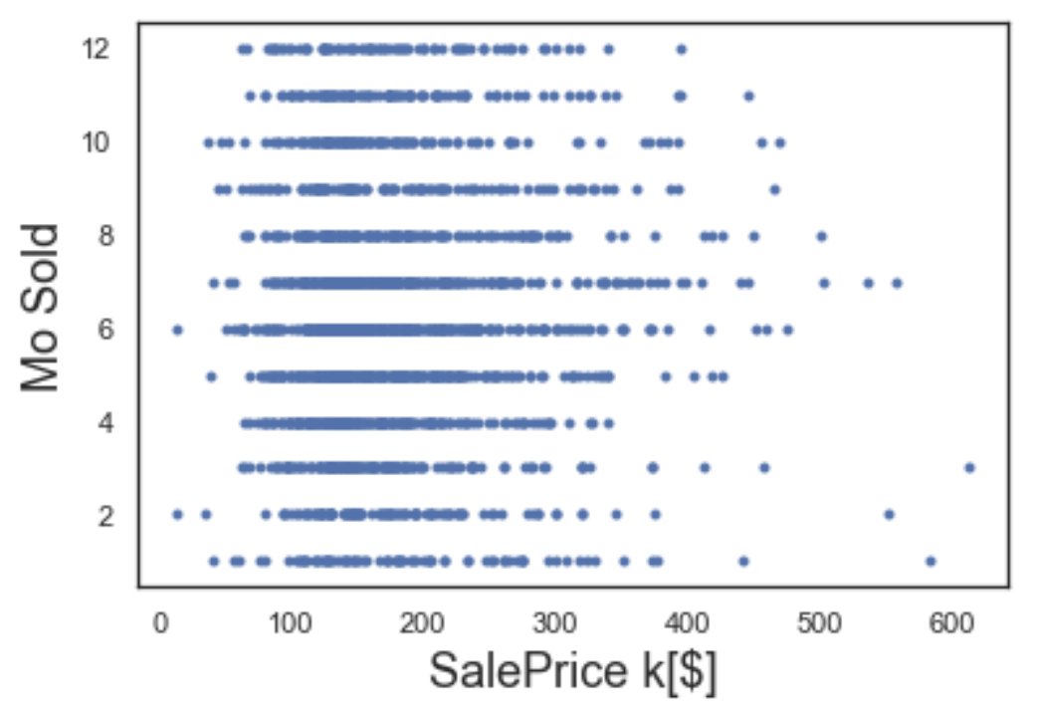
Features: Categorical with quality in numeric
17

Slide 18
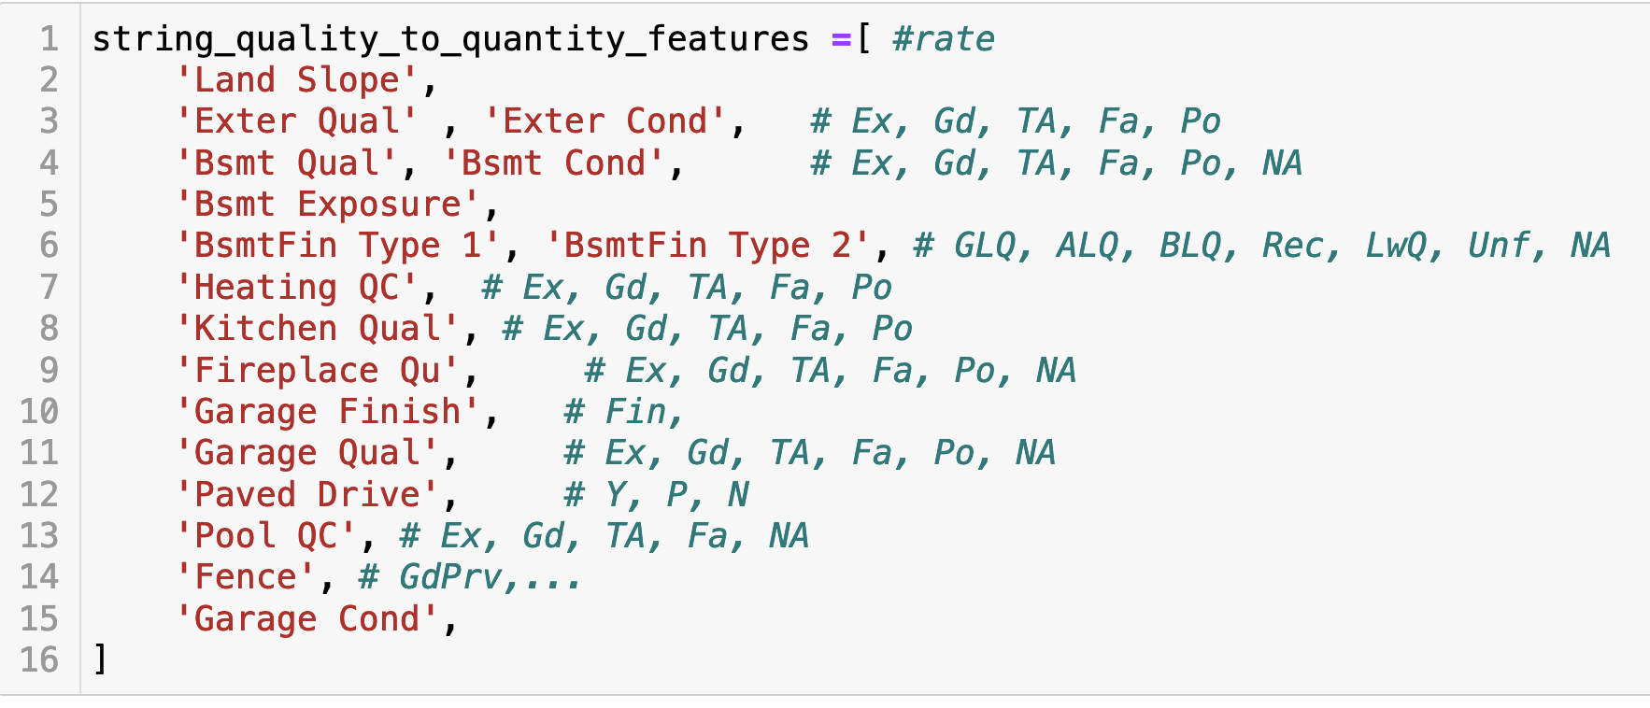
Features: quality features in a range of Excellent to poor
18

Slide 19
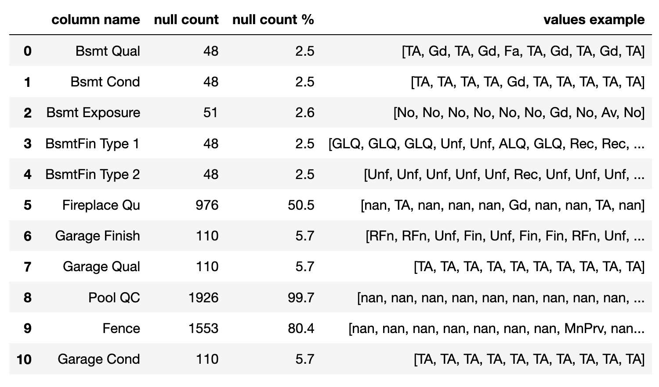
Quality features: Null treatment
19

Slide 20
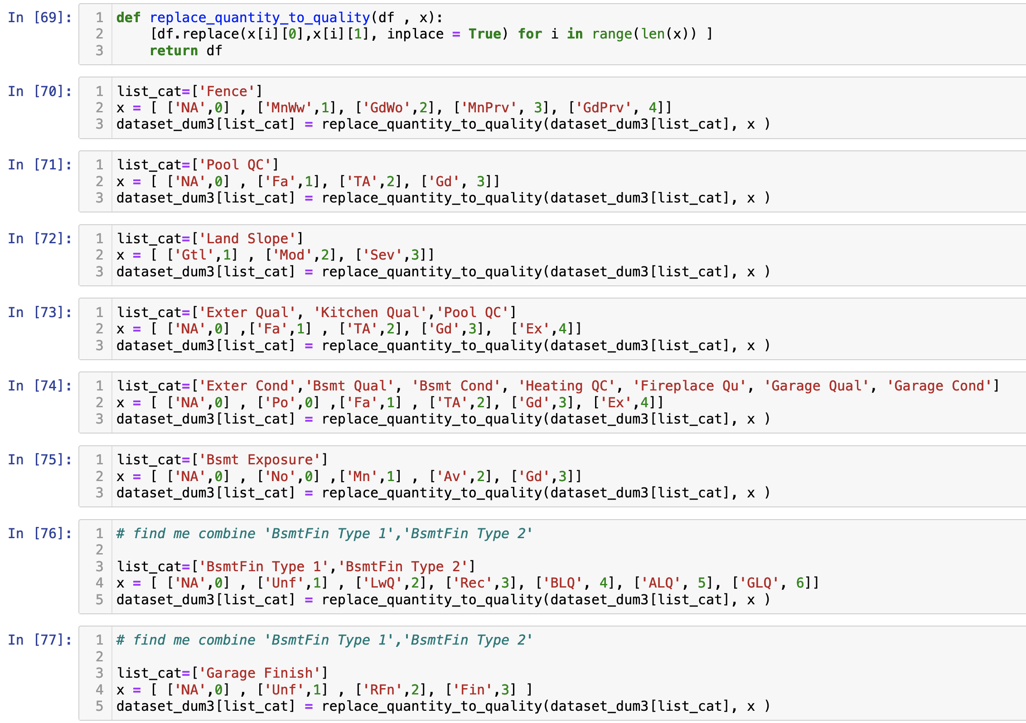
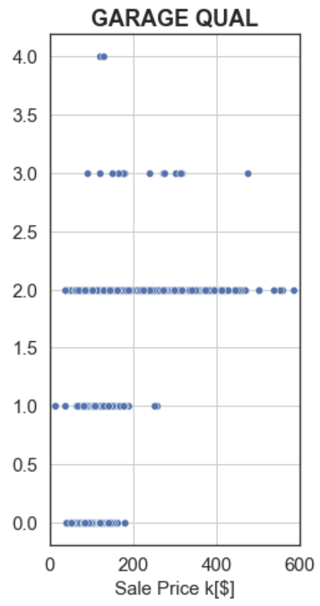
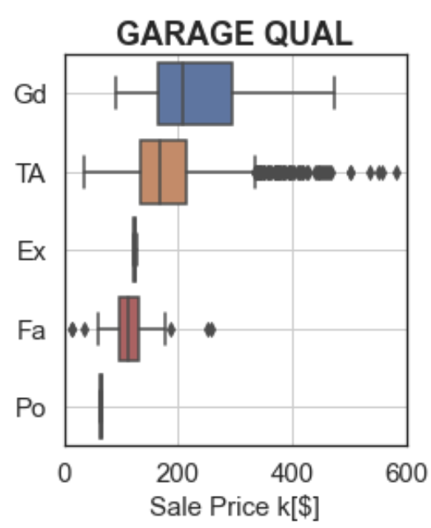
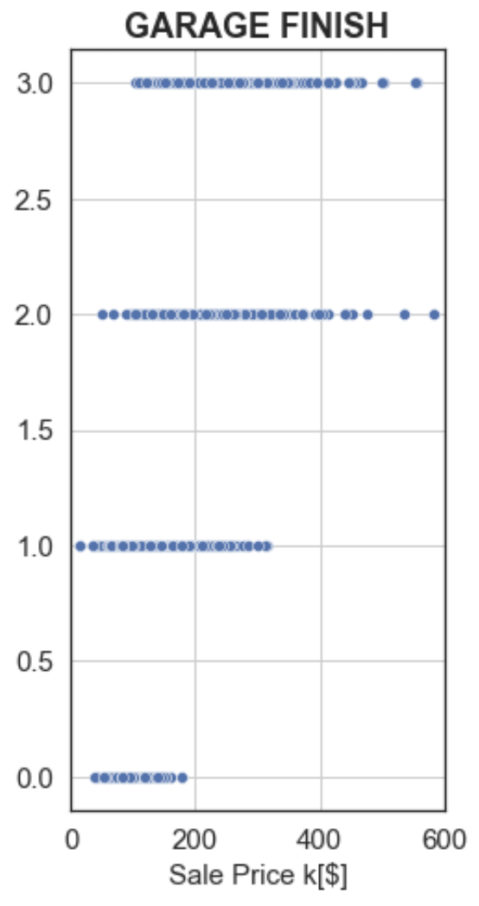
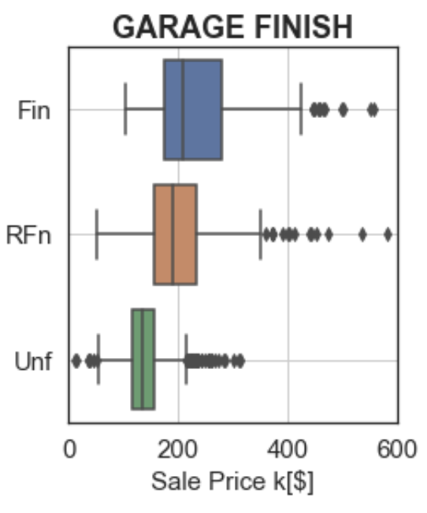
Quality features: Replace rates with numbers
20

Slide 21
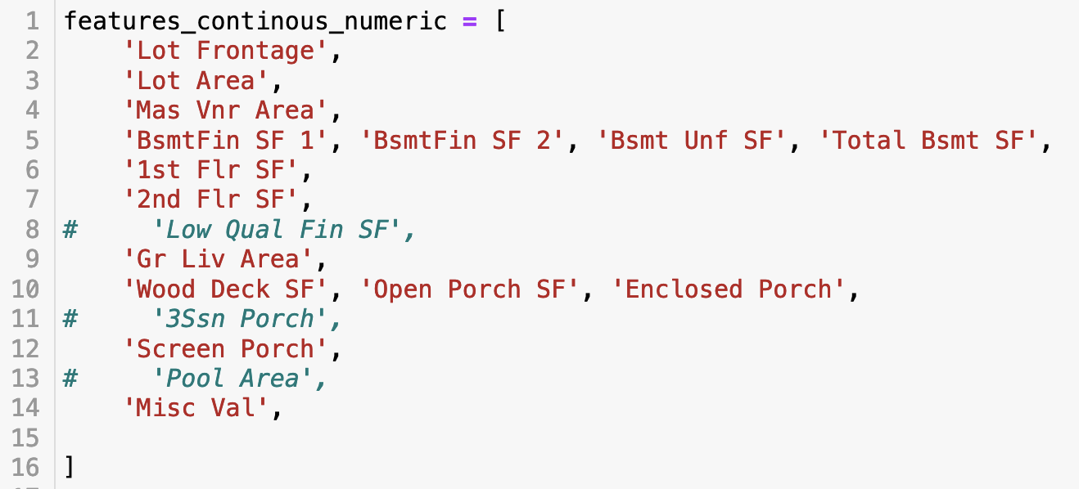
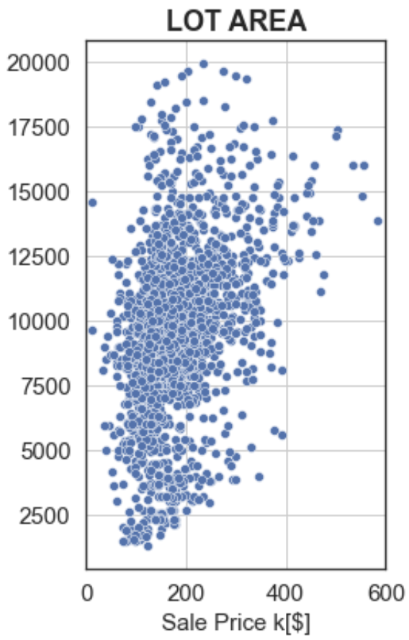
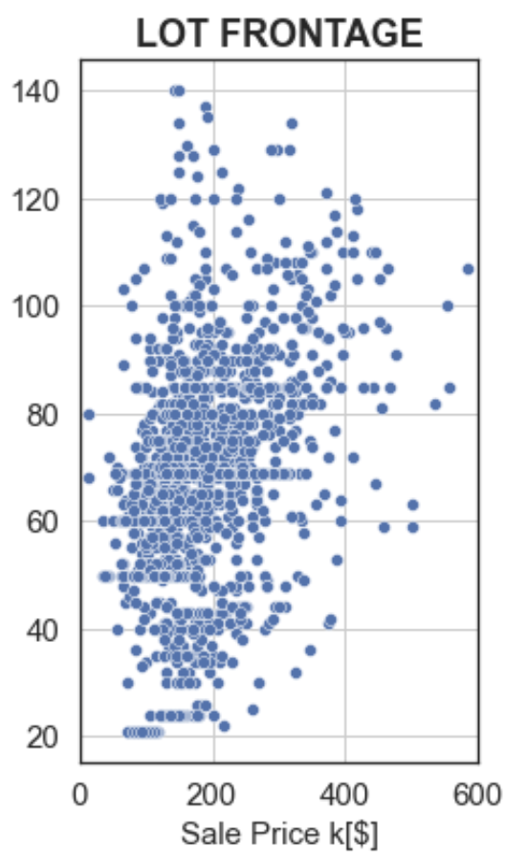
Features: Continous / numeric
21

Slide 22
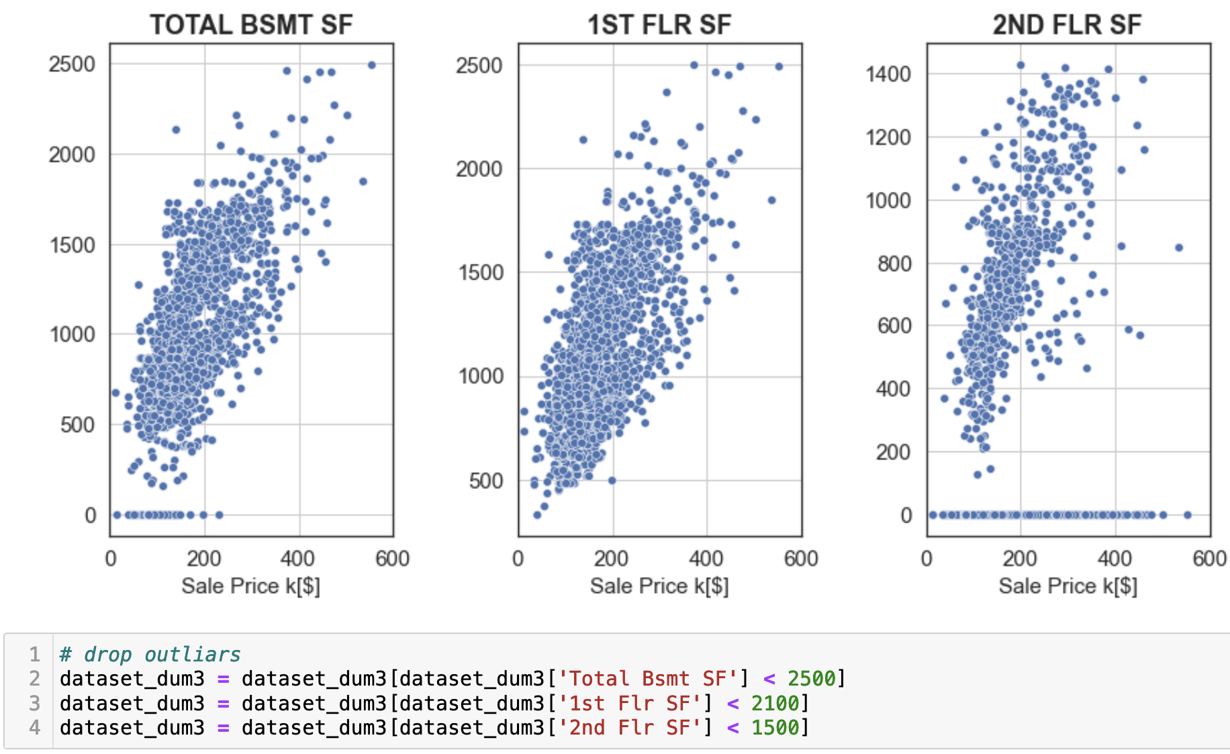
features_continous_numeric: Outliars
22

Slide 23
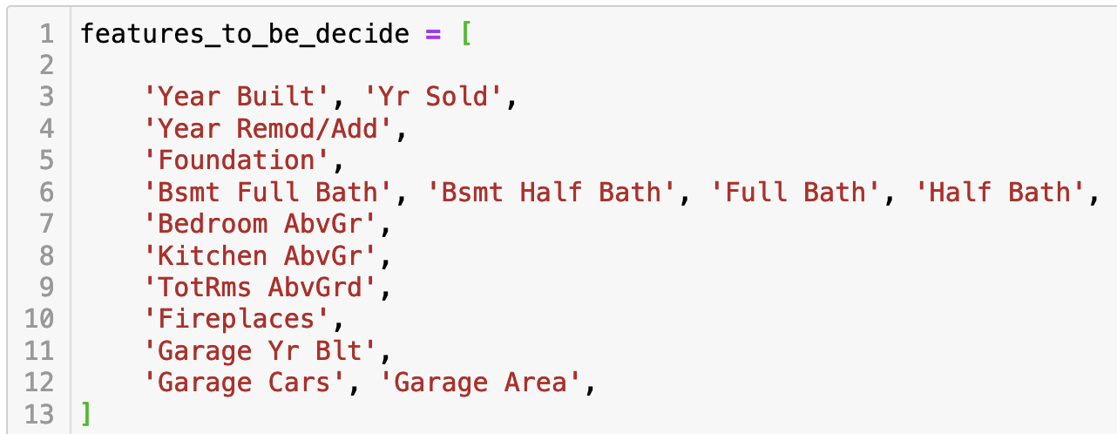
Features: for possible engineering
23

Slide 24
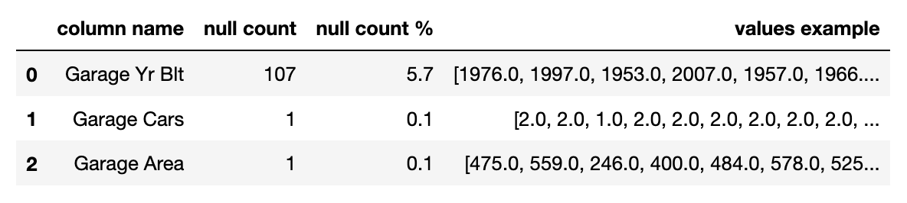
Features: for possible engeeniering: Null tratment
24

Slide 25
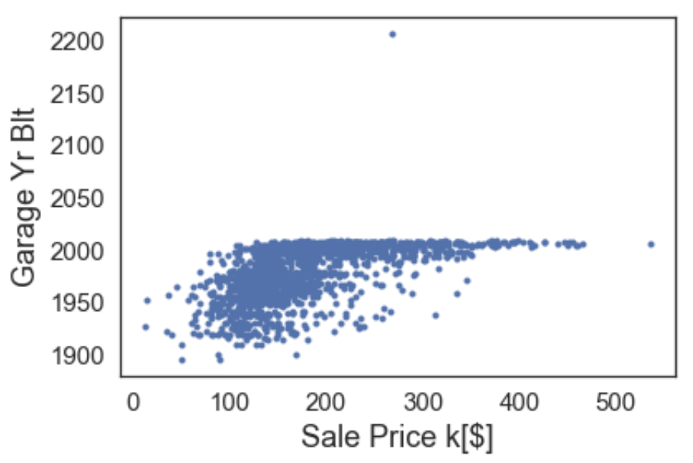
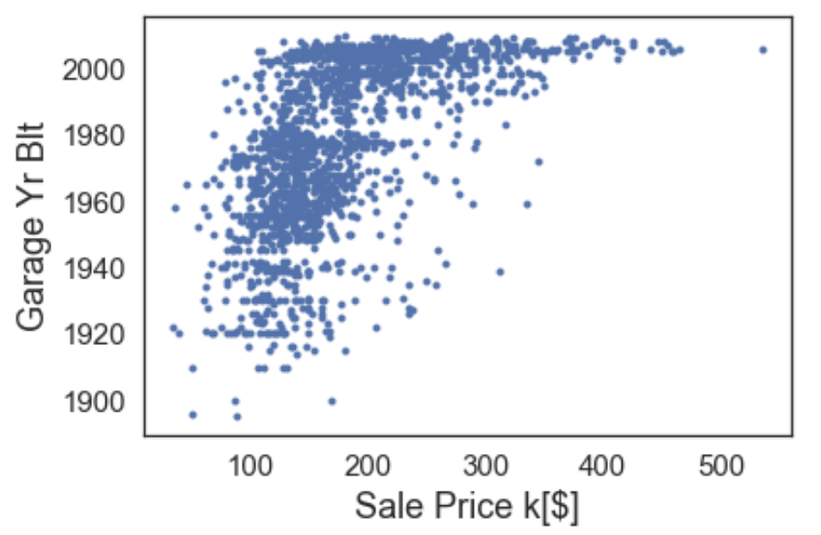
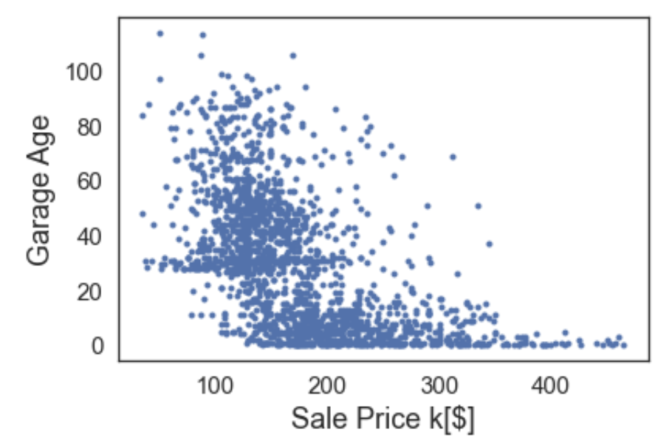
Features: for possible engeeniering: Outliars
25

Slide 26

Exploratory Data Analysis
Carmen Guedez

Slide 27
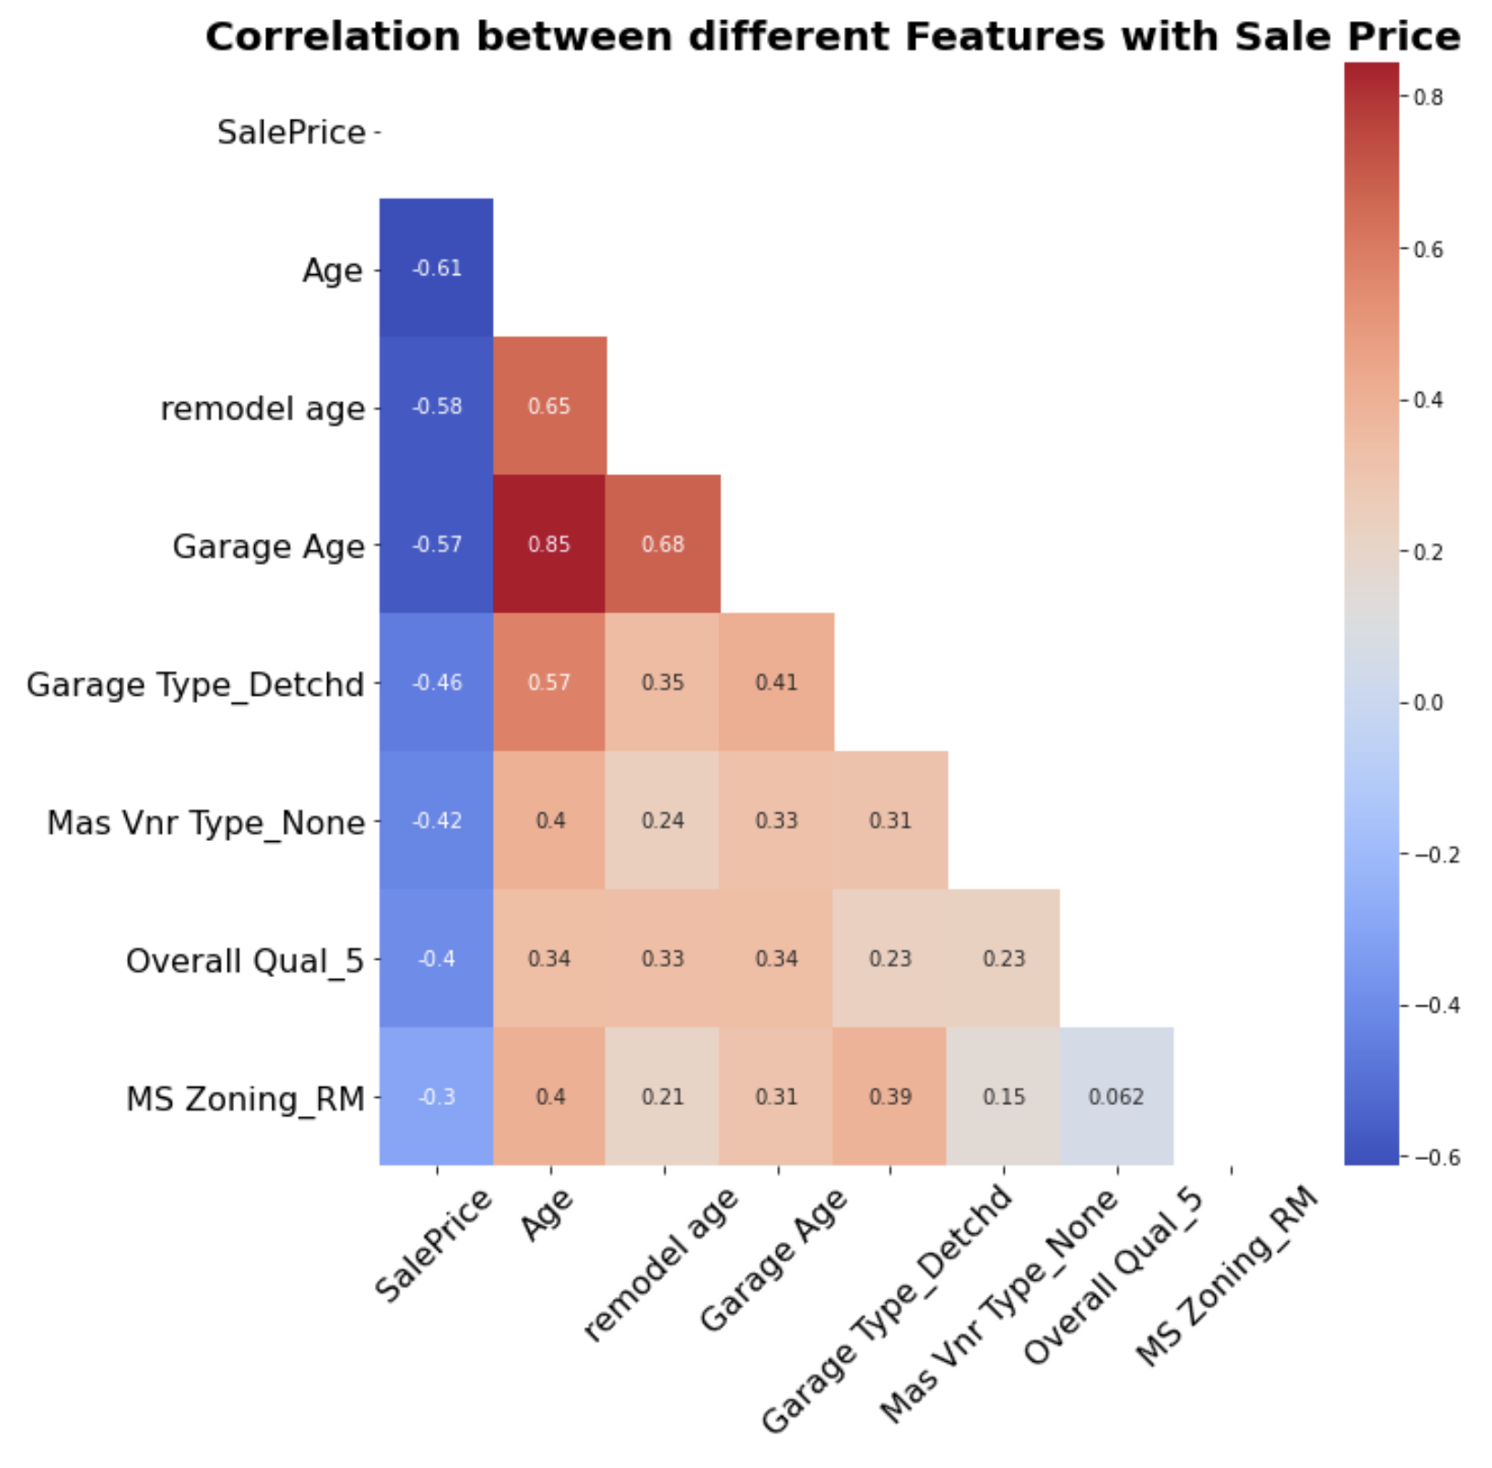
Features with the lowest correlation with SalePrice
27

Slide 28
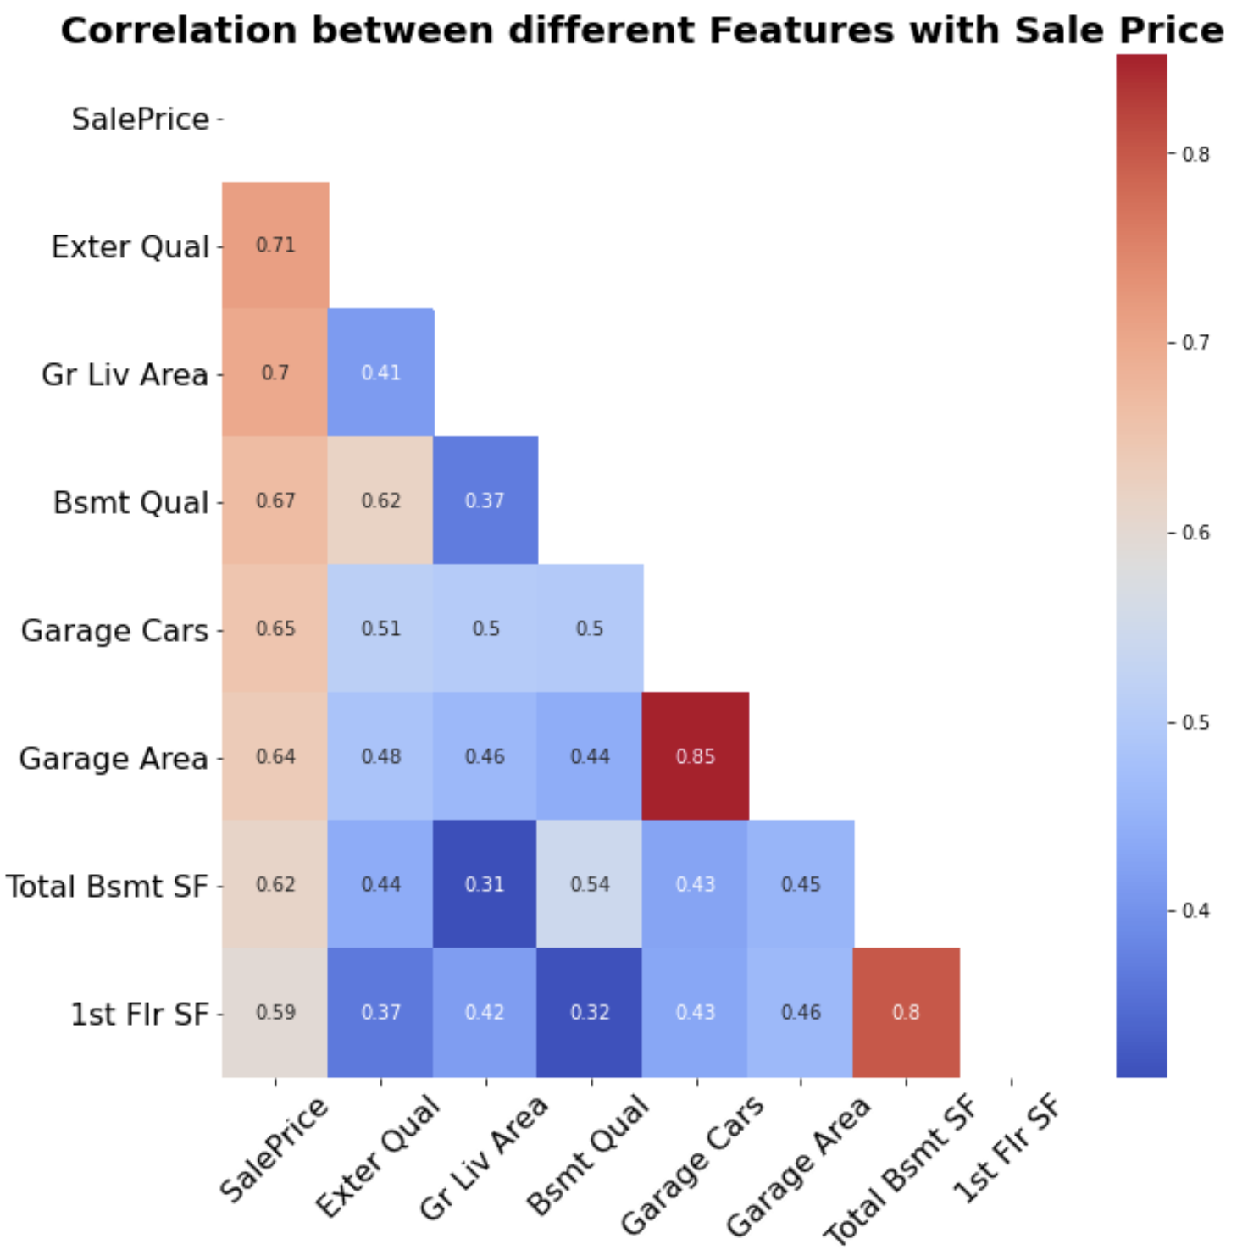
Features with the highest correlation with SalePrice
28

Slide 29
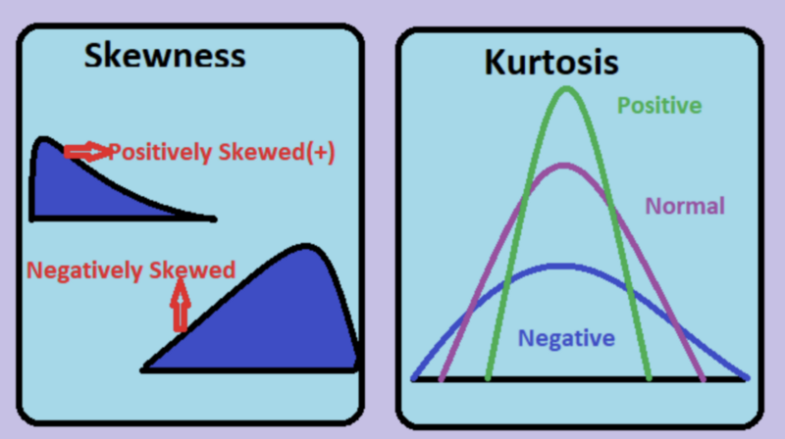
SKEWNESS assess the normality of our distribution whether it is symmetrical or not. (normal distribution is ZERO)
KURTOSIS evaluates the sharpness of the peak. (perfectly normal distribution is THREE)
https://www.statisticalaid.com/skewness-and-kurtosis-in-statistics-shape-of-distributions/
29

Slide 30
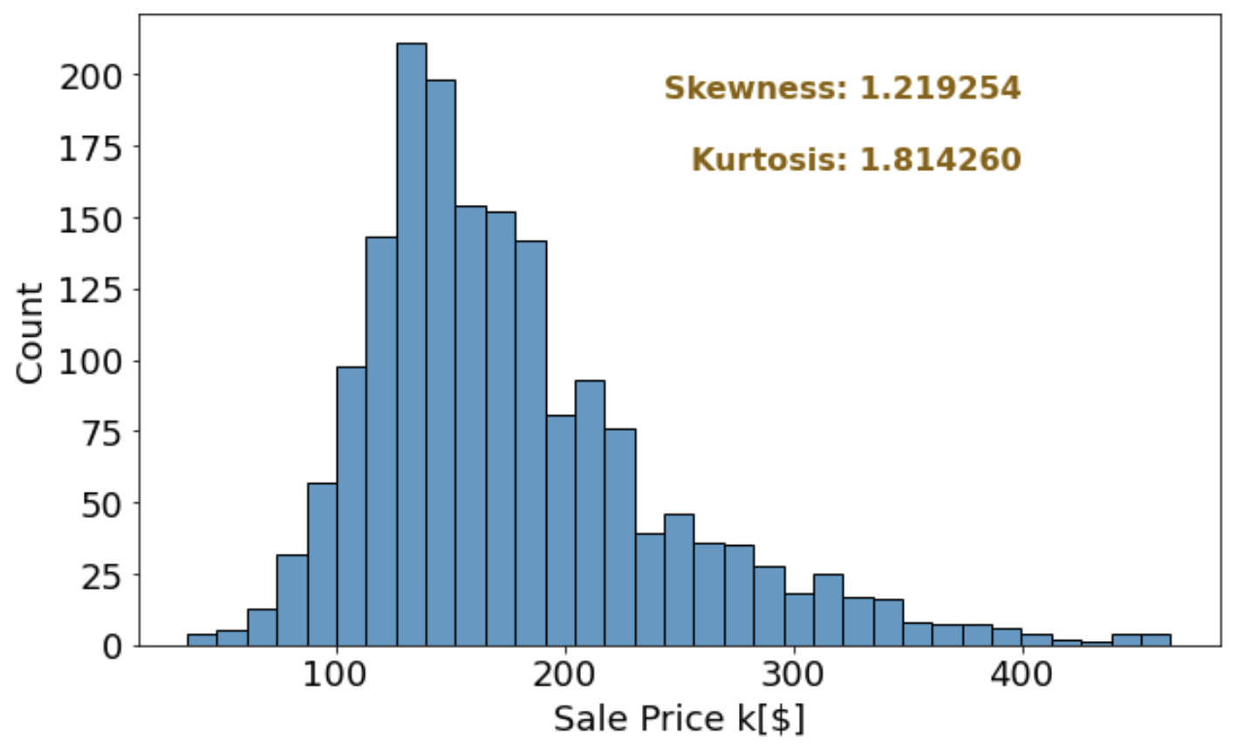
30

Slide 31

Modeling
(Illustrations by Jean-François Martin, washingtonpost)

Slide 32
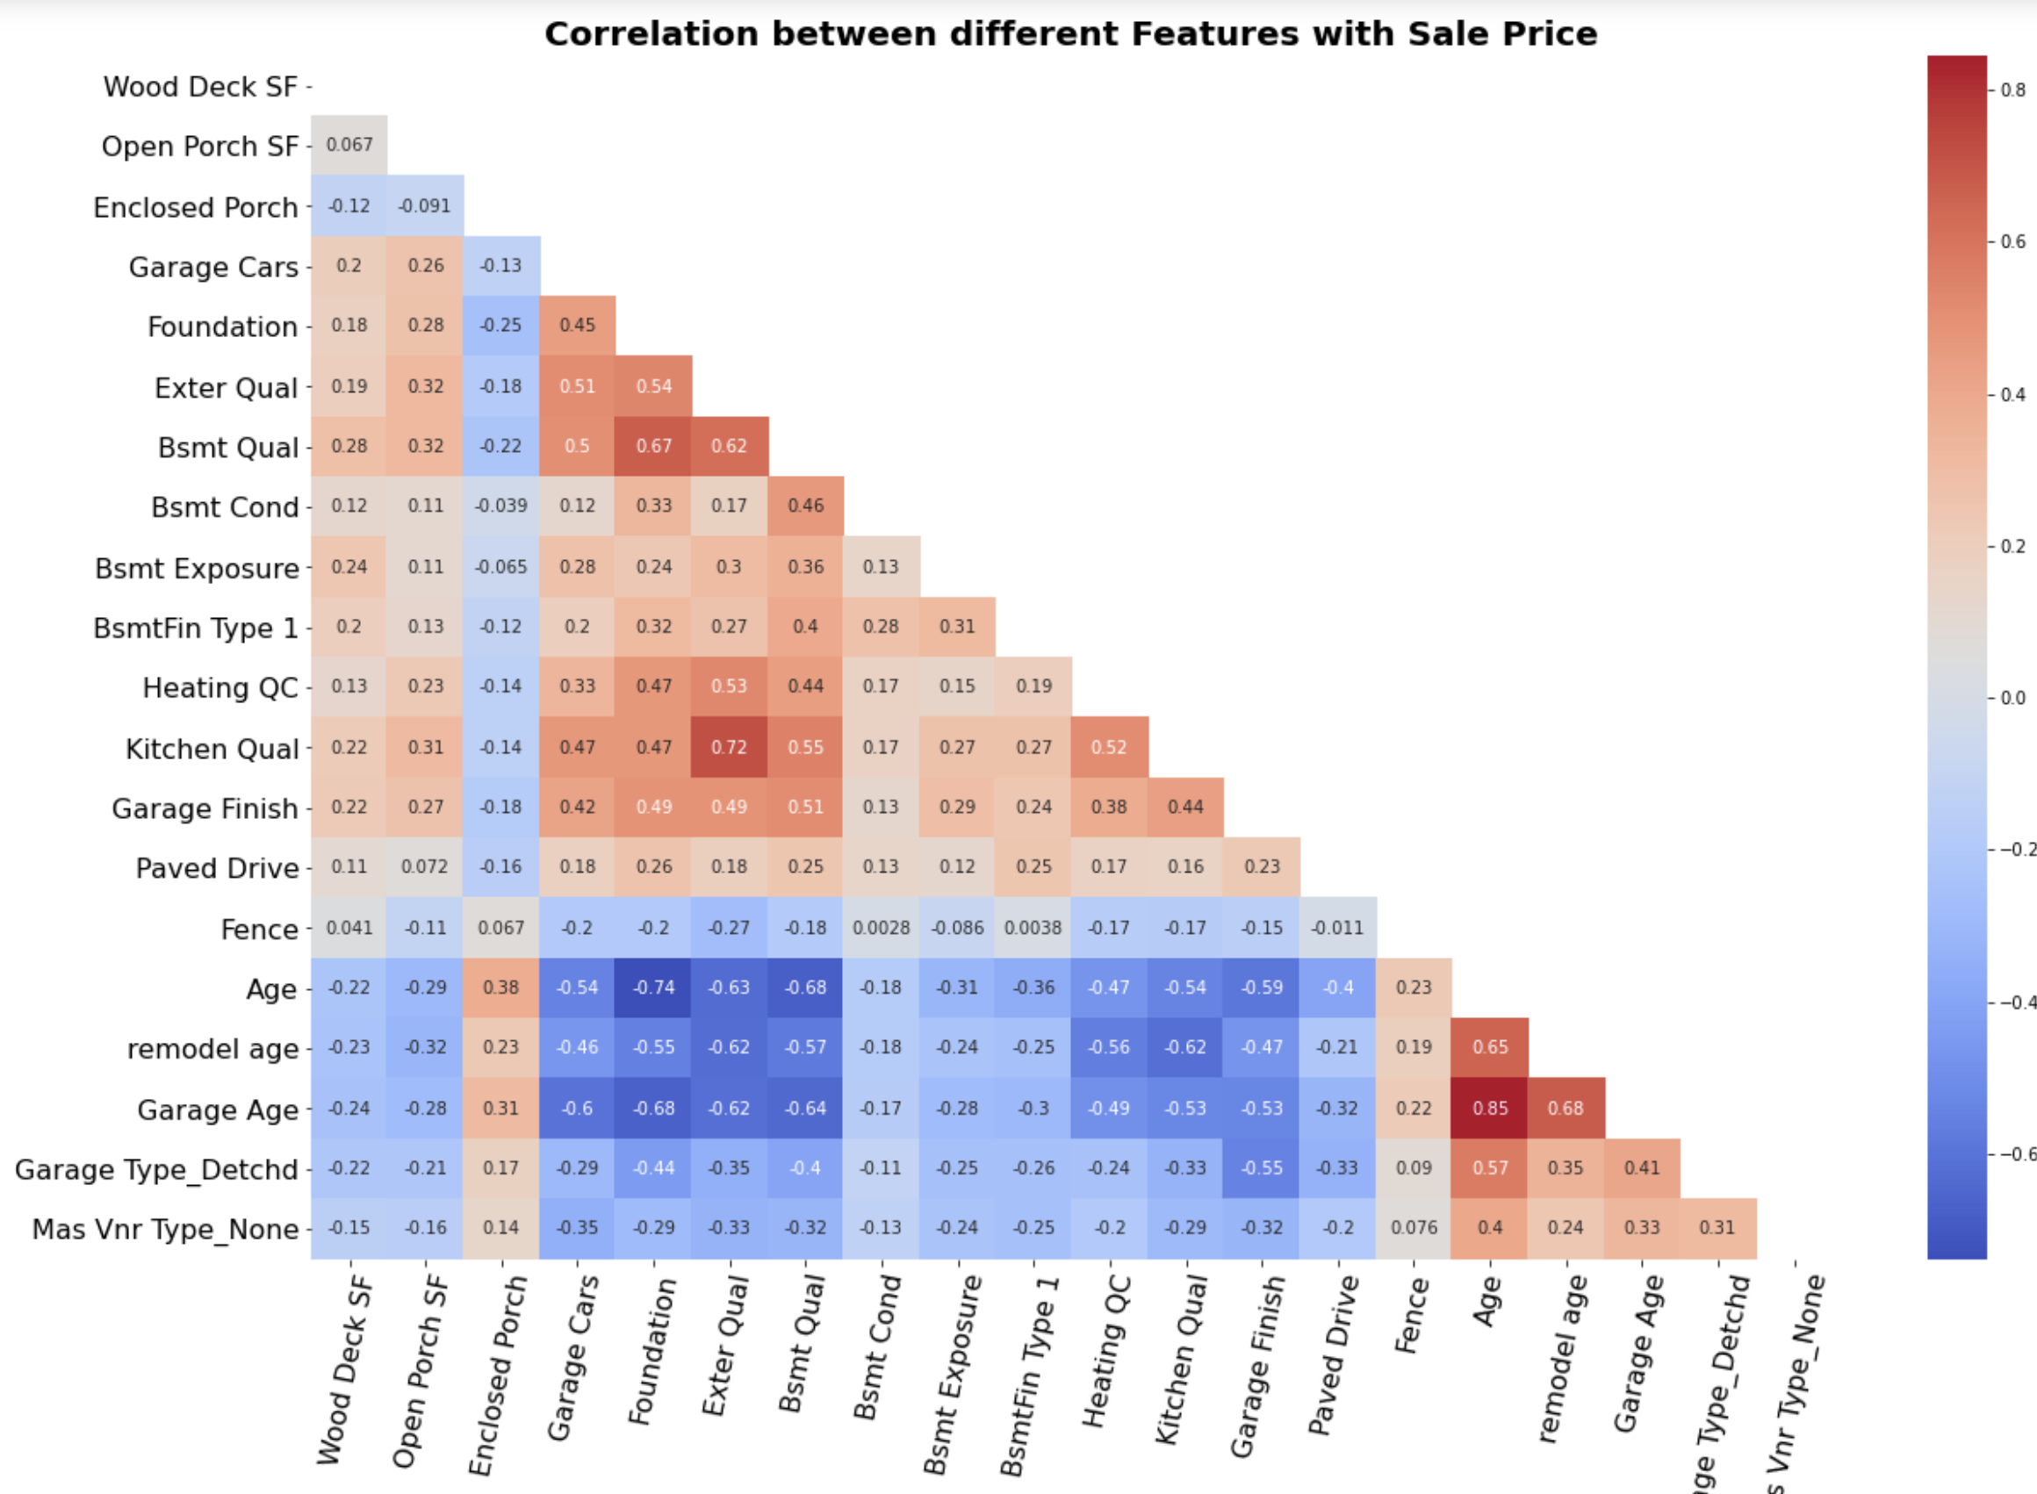
Linear Regression: Features
32

Slide 33
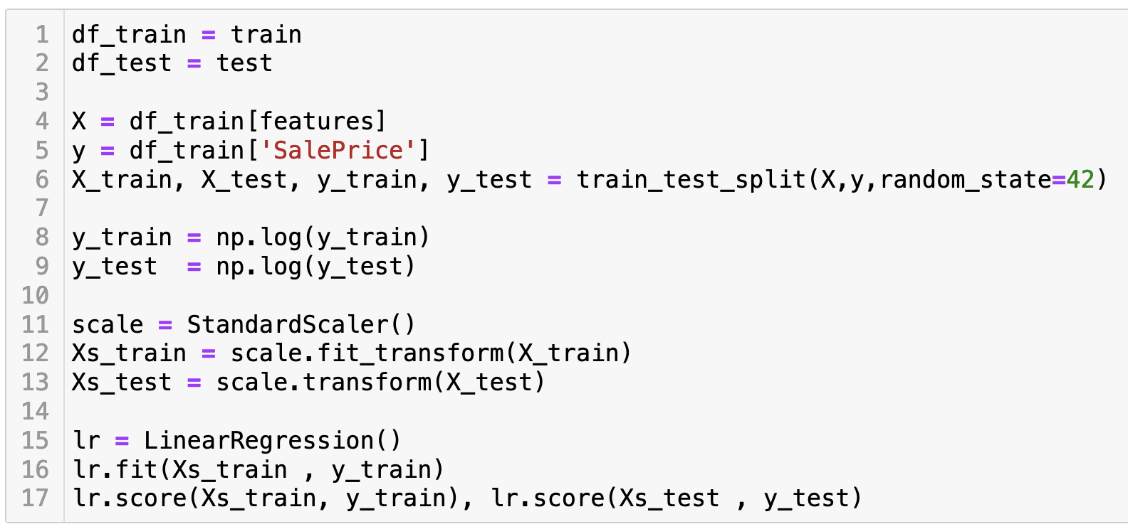
Linear Regression: Core script
33

Slide 34
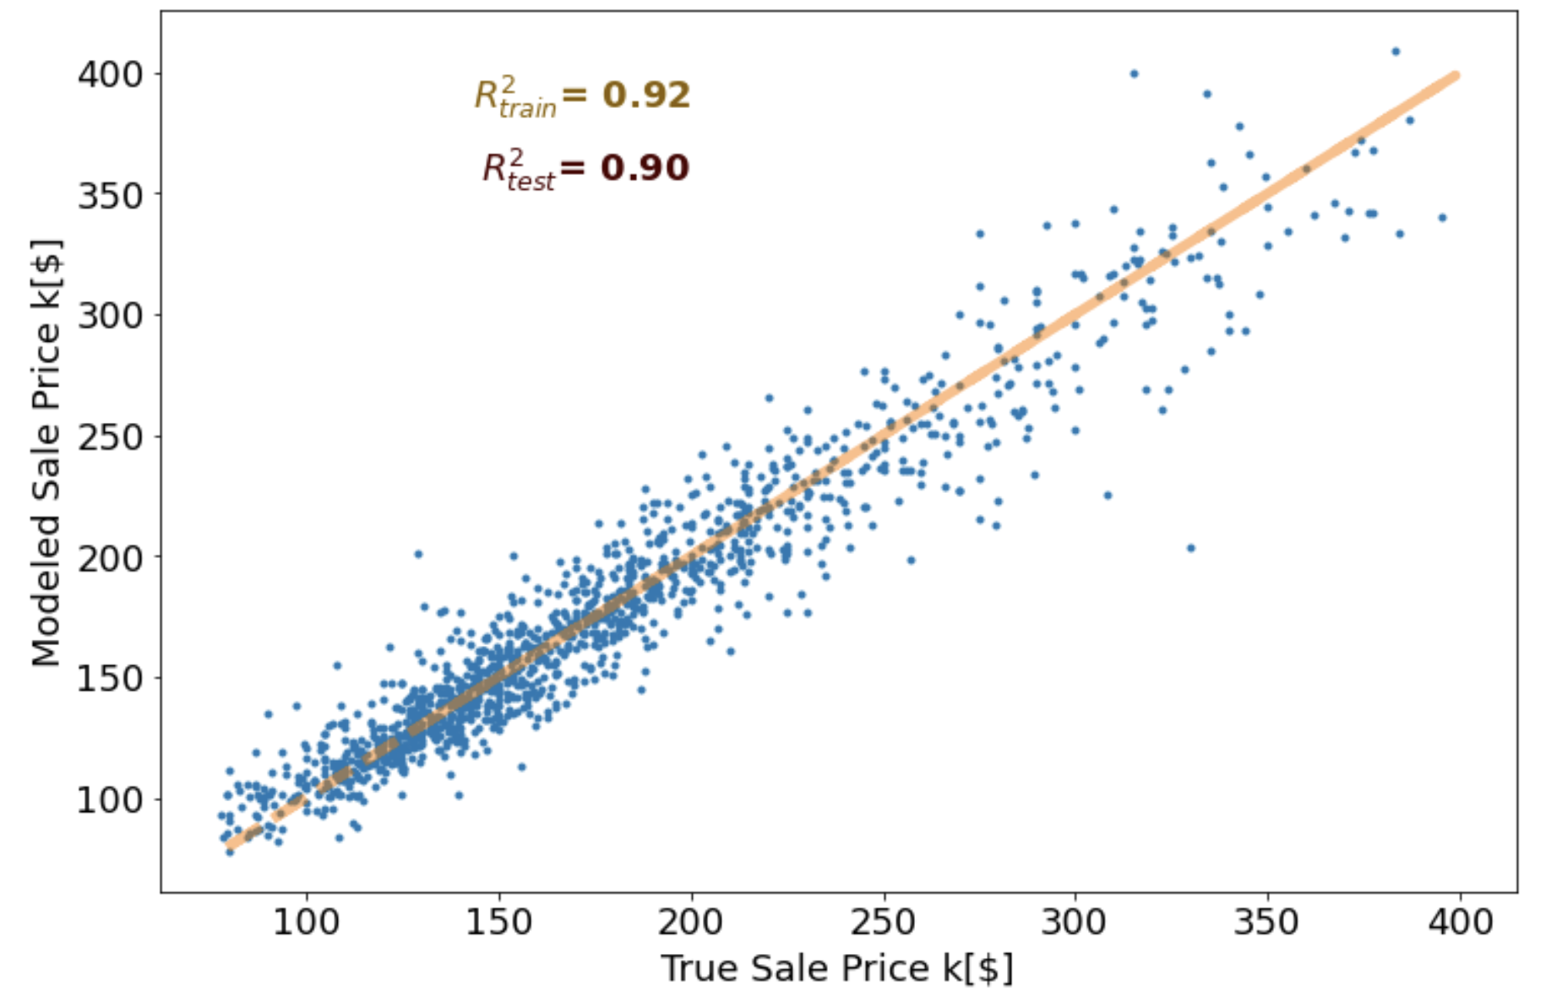
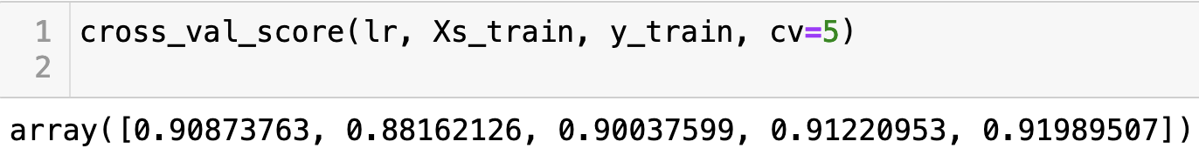
Linear Regression: Results
34

Slide 35

Linear Regression with Polynomial Features
35

Slide 36

Linear Regression with Polynomial Features: Code
36

Slide 37


Linear Regression with Polynomial Features: Results
37

Slide 38

Ridge Modeling: Code
38

Slide 39


Ridge Modeling: Results
39

Slide 40

Lasso Modeling: Code
40

Slide 41


Lasso Modeling: Results
41

Slide 42


Elastic Net Model: Code
42

Slide 43


Elastic Net Model : Results
43

Slide 44
Compare Different Models
Model Name | Number of Features | R²_{train} | R²_{test} | RMSE | R²_{train (CV=5)}
Linear Regression | 30 | 0.92 | 0.90 | 16721 | 0.91 , 0.88 , 0.90 , 0.91 , 0.92
Linear Regression with Polynomial Interactions | 22 | 0.94 | .85 | 14544 | 0.77 , 0.82 , 0.81 , 0.59 , 0.72
Ridge Regularization | 30 | 0.92 | 0.90 | 16754 | 0.91 , 0.88 , 0.90 , 0.91 , 0.92
Lasso Regularization | 30 | 0.93 | 0.90 | 17809 | 0.93 , 0.90 , 0.91 , 0.91 , 0.90
Elastic Net Regularization | 30 | 0.92 | 0.90 | 17501 | 0.91 , 0.90 , 0.86 , 0.90 , 0.89
44

Slide 45

Conclusion:
Linear Regression and generalization models in general require large number of features.
Linear Regression modeling with polynomial features could have the same prediction power is the features get selected properly.

